Slide 1

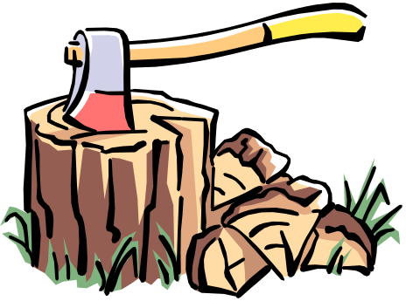

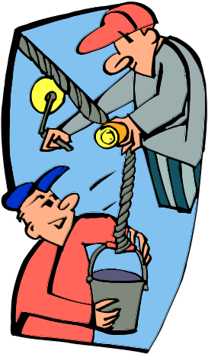
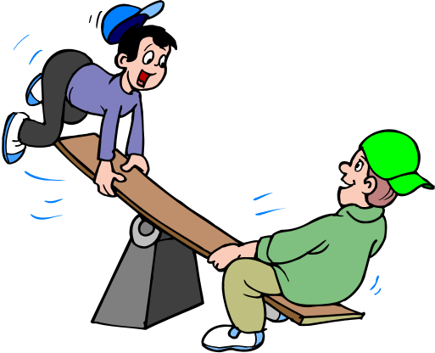
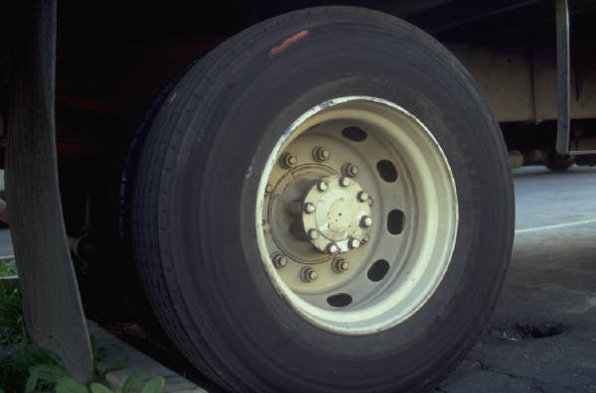
The 6 Simple Machines
Inclined Plane
Screw
Wedge
Pulley
Wheel and Axle
Lever

Slide 2
Definitions:
Energy:
Ability to do work
Work=
Force x Distance
Force:
A Push or a Pull

Slide 3
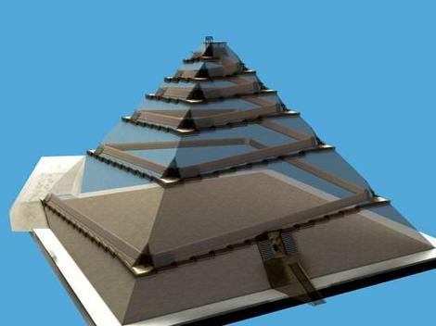
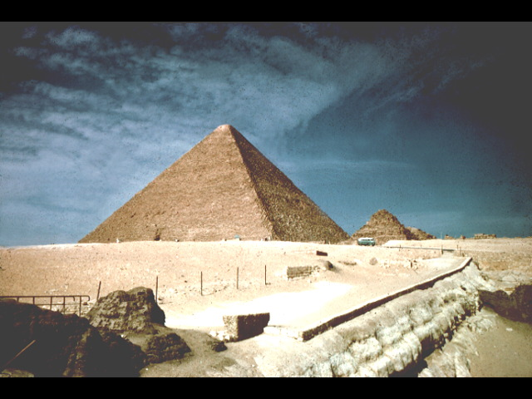
Inclined Plane

Slide 4
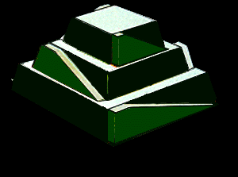
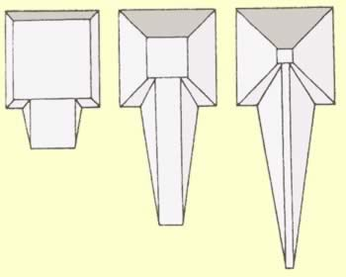
Inclined Plane
The Egyptians used simple machines to build the pyramids. One method was to build a very long incline out of dirt that rose upward to the top of the pyramid very gently. The blocks of stone were placed on large logs (another type of simple machine - the wheel and axle) and pushed slowly up the long, gentle inclined plane to the top of the pyramid.

Slide 5
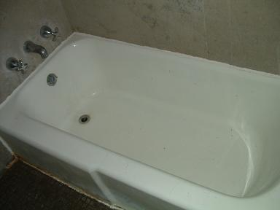
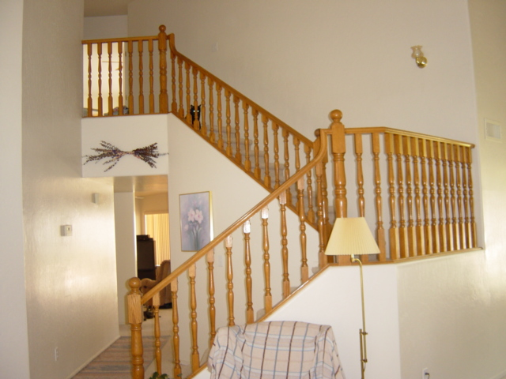
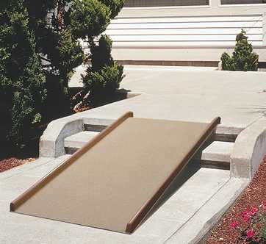
Inclined Planes
An inclined plane is a flat surface that is higher on one end
Inclined planes make the work of moving things easier
Notes:
A sloping surface, such as a ramp. An inclined plane can be used to alter the effort and distance involved in doing work, such as lifting loads. The trade-off is that an object must be moved a longer distance than if it was lifted straight up, but less force is needed.
You can use this machine to move an object to a lower or higher place. Inclined planes make the work of moving things easier. You would need less energy and force to move objects with an inclined plane.

Slide 6
Work input and output
Work input is the amount of work done on a machine.
  Input force x input distance
Work output is the amount of work done by a machine.
  Output force x output distance
Wout = Win
Fout x Dout = Fin x Din
10N x 3m = 2N x 15m
Din
15 m
Dout
3 m
Fin
10 N

Slide 7
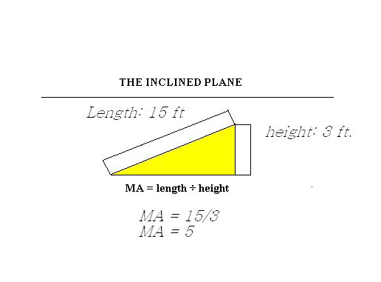
Inclined Plane -
Mechanical Advantage
The mechanical advantage of an inclined plane is equal to the length of the slope divided by the height of the inclined plane.
While the inclined plane produces a mechanical advantage, it does so by increasing the distance through which the force must move.

Slide 8
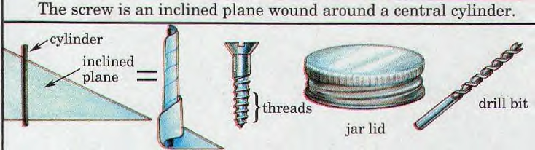
Screw
The mechanical advantage of an screw can be calculated by dividing the circumference by the pitch of the screw.
Pitch equals 1/ number of turns per inch.

Slide 9
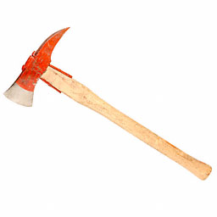
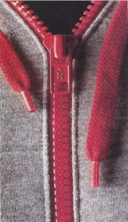
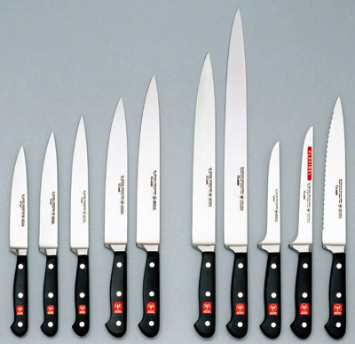
Wedges
Two inclined planes joined back to back.
Wedges are used to split things.

Slide 10
Wedge – Mechanical Advantage
The mechanical advantage of a wedge can be found by dividing the length of either slope (S) by the thickness (T) of the big end.
S
As an example, assume that the length of the slope is 10 inches and the thickness is 4 inches. The mechanical advantage is equal to 10/4 or 2 1/2. As with the inclined plane, the mechanical advantage gained by using a wedge requires a corresponding increase in distance.
T

Slide 11
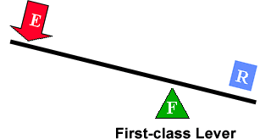
Fulcrum is between EF (effort) and RF (load)
Effort moves farther than Resistance.
Multiplies EF and changes its direction
The mechanical advantage of a lever is the ratio of the length of the lever on the applied force side of the fulcrum to the length of the lever on the resistance force side of the fulcrum.
First Class Lever

Slide 12
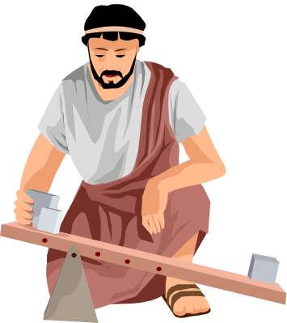

First Class Lever
.
  Common examples of first-class levers include crowbars, scissors, pliers, tin snips and seesaws.

Slide 13
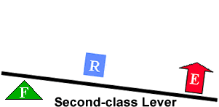
RF (load) is between fulcrum and EF
Effort moves farther than Resistance.
Multiplies EF, but does not change its direction
The mechanical advantage of a lever is the ratio of the distance from the applied force to the fulcrum to the distance from the resistance force to the fulcrum.
Second Class Lever

Slide 14
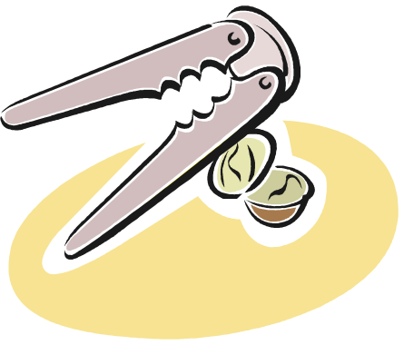
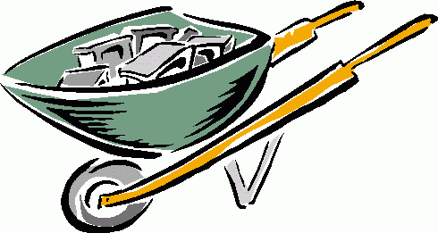
Second Class Lever
Examples of second-class levers include nut crackers, wheel barrows, doors, and bottle openers.

Slide 15
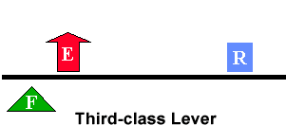
EF is between fulcrum and RF (load)
Does not multiply force
Resistance moves farther than Effort.
Multiplies the distance the effort force travels
The mechanical advantage of a lever is the ratio of the distance from the applied force to the fulcrum to the distance of the resistance force to the fulcrum
Third Class Lever

Slide 16
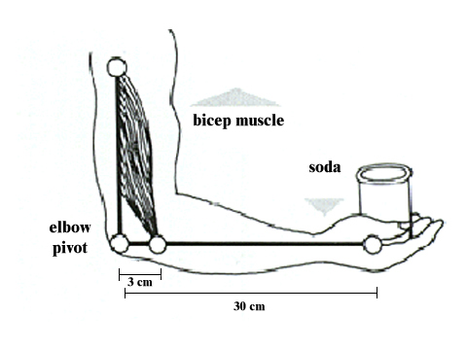

Third Class Lever
Examples of third-class levers include tweezers, arm hammers, and shovels.

Slide 17
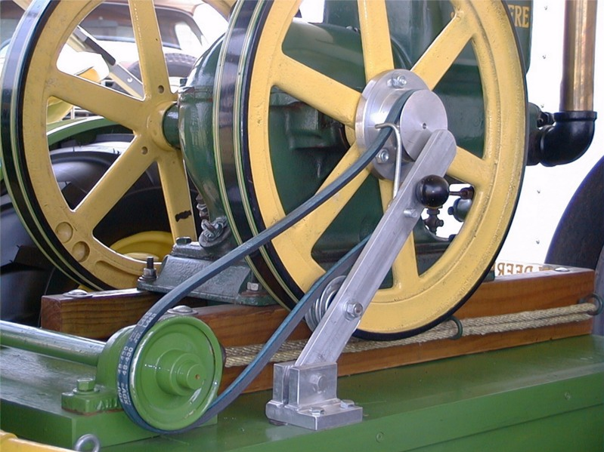
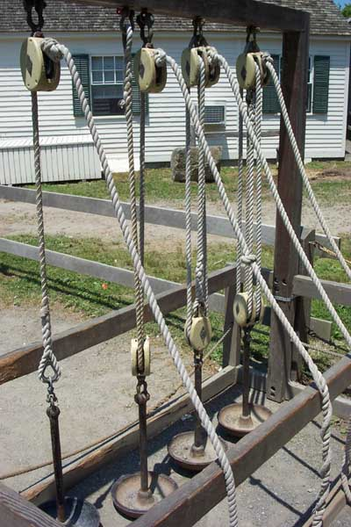
Pulleys
Pulley are wheels and axles with a groove around the outside
A pulley needs a rope, chain or belt around the groove to make it do work

Slide 18
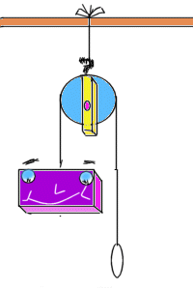
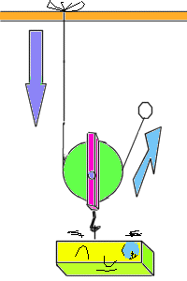
Diagrams of Pulleys
Fixed pulley:
A fixed pulley changes the direction of a force; however, it does not create a mechanical advantage.
Movable Pulley:
The mechanical advantage of a moveable pulley is equal to the number of ropes that support the moveable pulley.

Slide 19
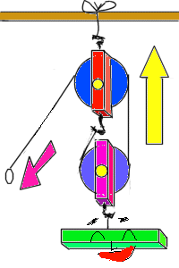
COMBINED PULLEY
The effort needed to lift the load is less than half the weight of the load.
The main disadvantage is it travels a very long distance.

Slide 20
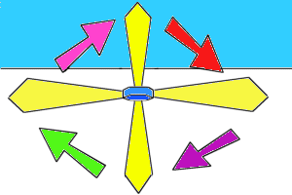
WHEEL AND AXEL
The axle is stuck rigidly to a large wheel. Fan blades are attached to the wheel. When the axel turns, the fan blades spin.

Slide 21
Wheel and Axel
The mechanical advantage of a wheel and axle is the ratio of the radius of the wheel to the radius of the axle.
In the wheel and axle illustrated above, the radius of the wheel is five times larger than the radius of the axle. Therefore, the mechanical advantage is 5:1 or 5.
The wheel and axle can also increase speed by applying the input force to the axle rather than a wheel. This increase is computed like mechanical advantage. This combination would increase the speed 5 times.
1
5

Slide 22
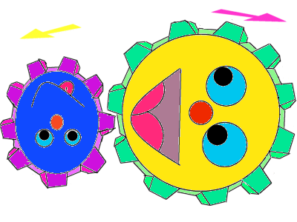
GEARS-Wheel and Axel
Each gear in a series reverses the direction of rotation of the previous gear. The smaller gear will always turn faster than the larger gear.

Slide 23
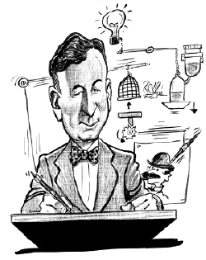
Rube Goldberg Machines
Rube Goldberg machines are examples of complex machines.
All complex machines are made up of combinations of simple machines.
Rube Goldberg machines are usually a complicated combination of simple machines.
By studying the components of Rube Goldberg machines, we learn more about simple machines

Slide 24
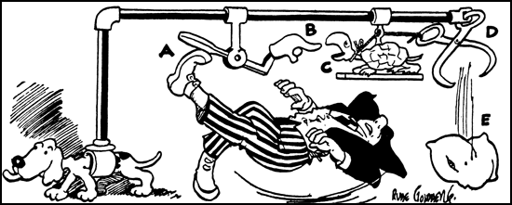
Safety Device for Walking on Icy Pavements
When you slip on ice, your foot kicks paddle (A),
lowering finger (B), snapping turtle (C) extends neck
to bite finger, opening ice tongs (D) and dropping pillow (E),
thus allowing you to fall on something soft.

Slide 25

Squeeze Orange Juice
Rube Goldberg Machine

